Slide 1

React js ecosystem

Slide 2
Contents
History
SPA
Angular vs React
React architecture
Ecosystem
Discussion

Slide 3


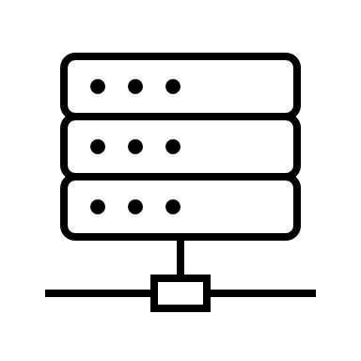
History
req

Slide 4

History
res

Slide 5
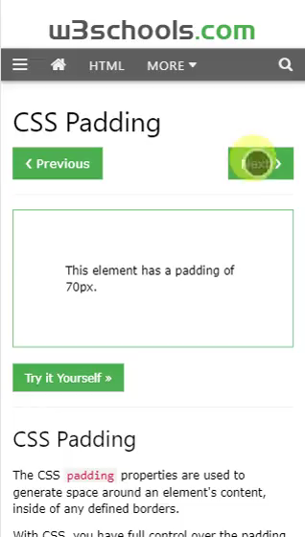
History
res

Slide 6
History
AJAX
req

Slide 7
History
AJAX
res

Slide 8
History
AJAX
req

Slide 9
History
AJAX
res

Slide 10



AJAX was good for Single page
Every time the user moved between pages, a new page was loaded

Slide 11

History Single Page Application
SPA
res

Slide 12
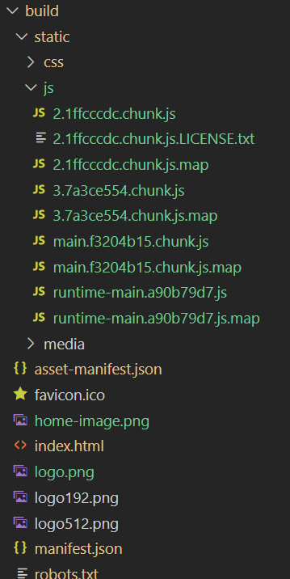


Single page application

Slide 13
History Single Page Application
SPA
res

Slide 14
History Single Page Application
SPA
res

Slide 15
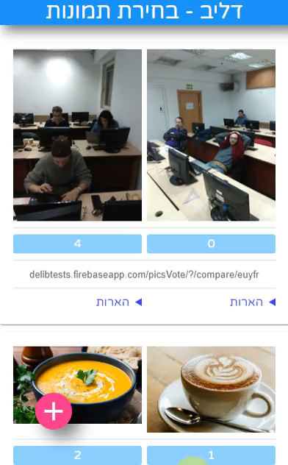
History Single Page Application
SPA

Slide 16
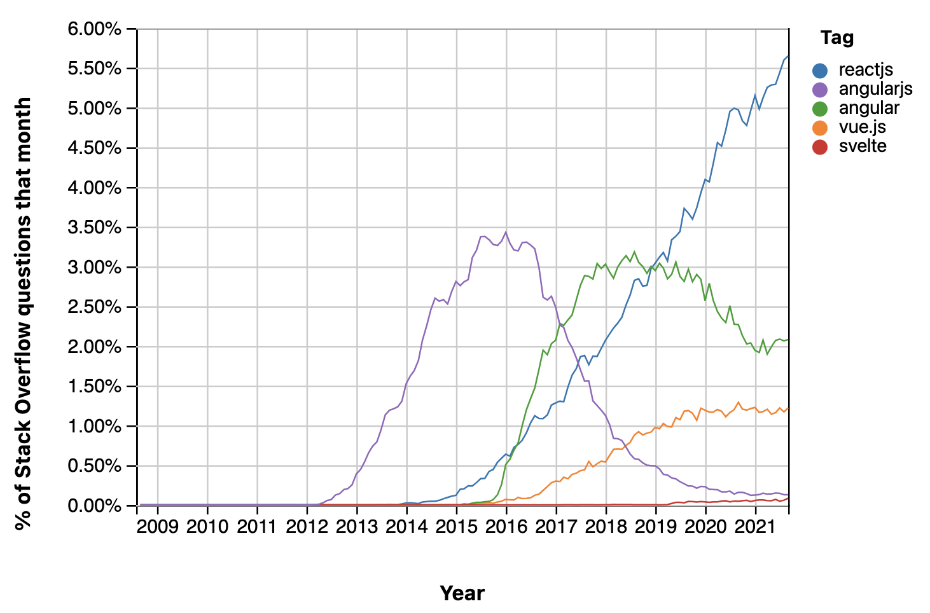
History Single Page Application
By: Tanguy Kotoff

Slide 17





Compare

Slide 18
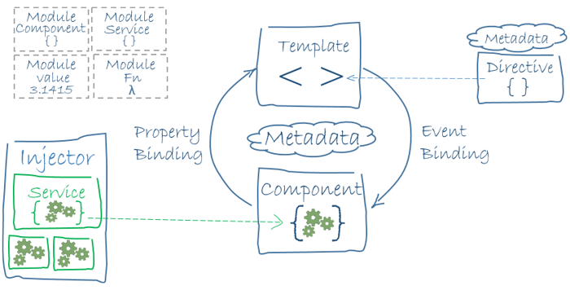
Angular vs react
Framework
Library

Slide 19


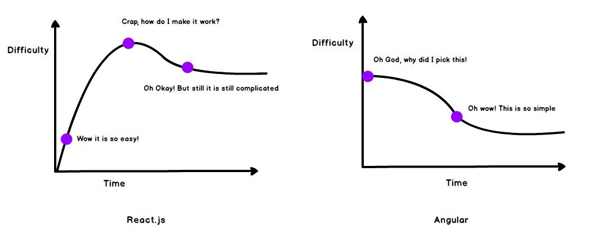
Angular vs react
Framework
Library
https://medium.com/@kanth.vallampati/why-angular-is-the-right-choice-for-enterprise-level-applications-over-react-9063dc742902

Slide 20
Angular vs react
Framework
Typescript
Event driven (observables)
Library
Can add Typescript
Non opinionated
https://medium.com/@kanth.vallampati/why-angular-is-the-right-choice-for-enterprise-level-applications-over-react-9063dc742902

Slide 21
Angular vs react
Framework
Typescript
Event driven (observables)
A complete solution
Medium ecosystem
Library
Can add Typescript
Non opinionated
Add what ever you like
Huge ecosystem
React-router-dom
Redux
Next.js
React native
Martial-UI
https://medium.com/@kanth.vallampati/why-angular-is-the-right-choice-for-enterprise-level-applications-over-react-9063dc742902

Slide 22

Ecosystem
https://viviross.vercel.app/

Slide 23

Ecosystem

Slide 24
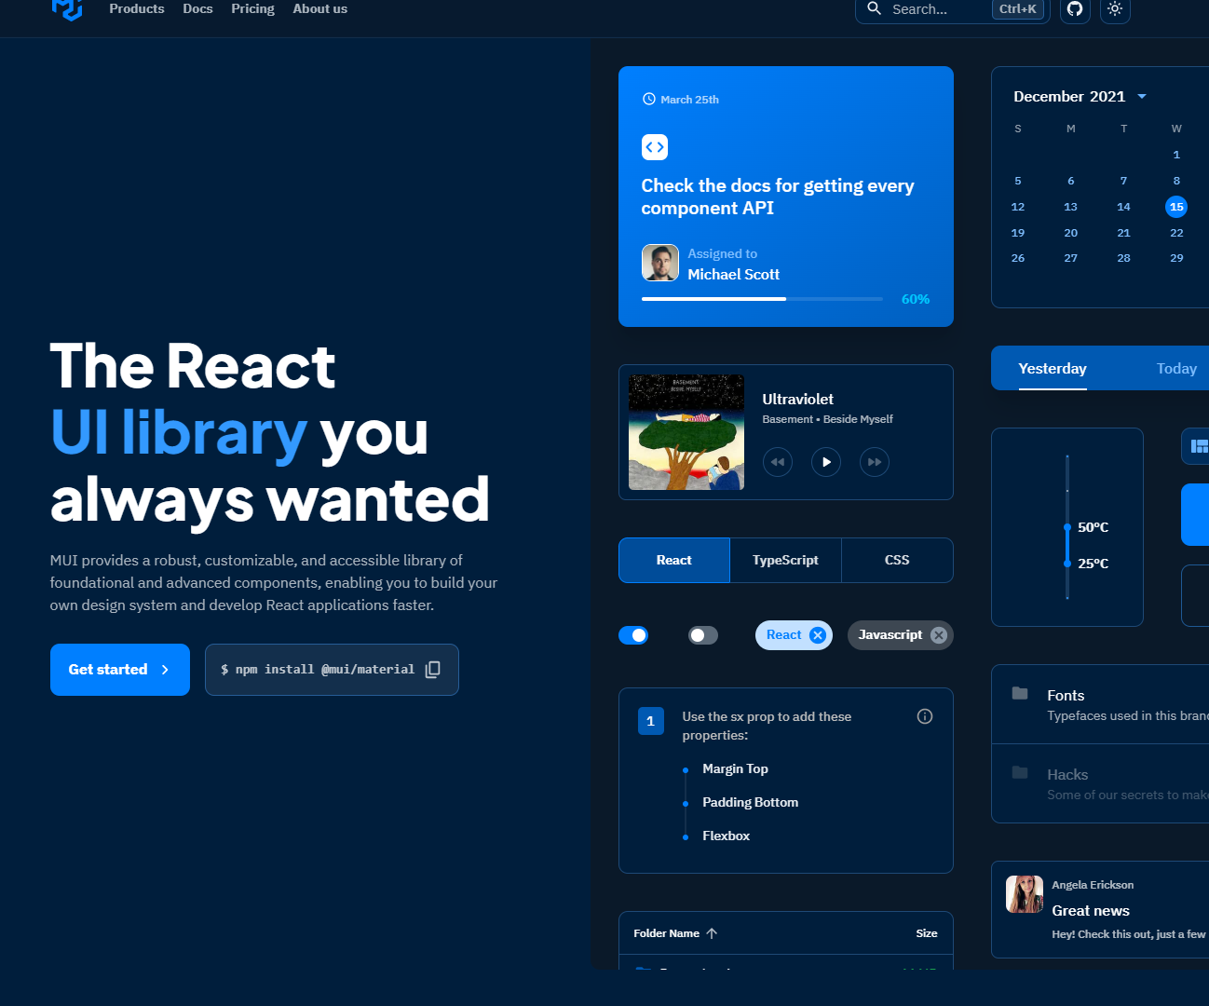
Material-UI

Slide 25
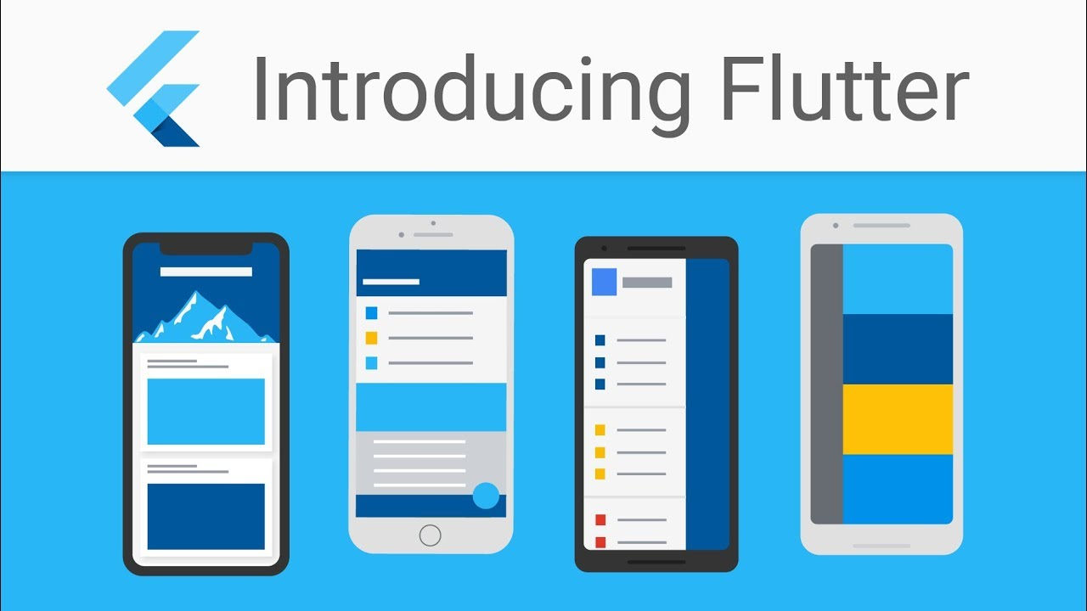
Angular vs react
Framework
Typescript
Event driven (observables)
A complete solution
Medium ecosystem
Library
Can add Typescript
Non opinionated
Add wat ever you like
Huge ecosystem
React-router-dom
Redux
Next.js
React native
Martial-UI
https://medium.com/@kanth.vallampati/why-angular-is-the-right-choice-for-enterprise-level-applications-over-react-9063dc742902

Slide 26

Architecture

Slide 27
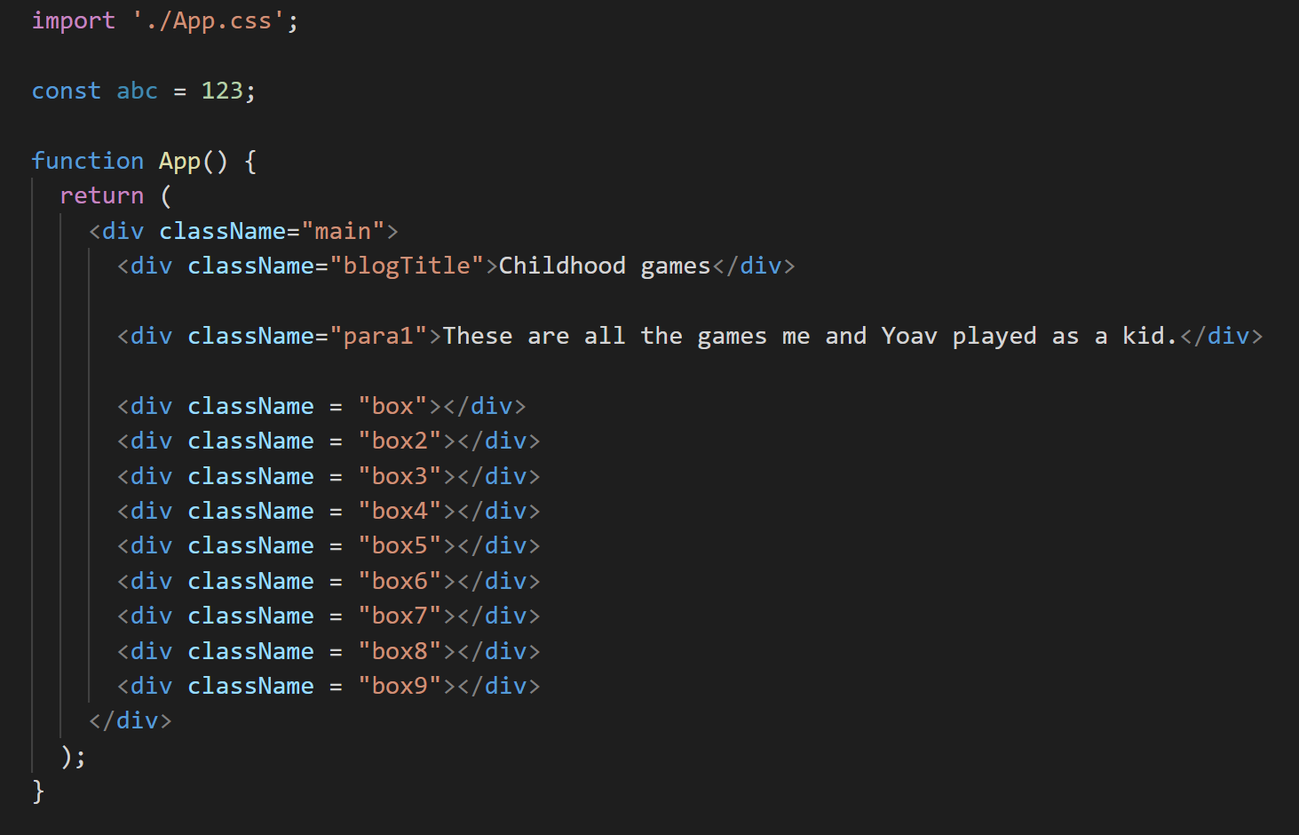
Page 1
Local data
Page 1
Page 1
Page 3
Components
Components
app state

Slide 28
Components
Page 1
Local data
(state)
Page 1
Page 1
Page 3
Components
Components

Slide 29
Passing data from top to bottom
<Components title=‘something’ />
Props
Components
<div>{props.title}</div>

Slide 30
State (Visualized data)
app state
Page 1
Local data
Page 1
Page 1
Page 3
Components
Components

Slide 31



State (Visualized data)
app state
MobX
Page 1
Page 1
Local data
Page 1
Page 3
Components
Components

